Slide 1


Introduction to
Robotic Process Automation
Email Response Sys
220701117
Kamal JR
Mrs. J. Jinu Sophia
Assistant Professor (SG)

Slide 2
Abstract
The designed advanced automated e-mail response system built with UiPath is meant to make communication workflows on e-mails easier and more efficient. Here is how the system acquires unread e-mails; and analyzes its content, using advanced keyword recognition and conditional reasoning. The system generates contextually appropriate responses via SMTP, matching all the criteria set based on the analysis. The system thus ensures prompt and accurate responses without human intervention. In addition, it tracks every engagement in an Excel file, so there can never be a loss of an overall audit trail comprising recipient details, date, and reply. Having inbuilt error-handling capabilities, the solution incorporates robustness and reliability, making it a good tool for companies to handle customer inquiries, internal communications, and other email-related operations. Simply put, this system not only reduces human workload but also enhances operational efficiency, scalability, and communication productivity in general.

Slide 3
Need for the Proposed System
The Automated Email Response System is crucial in the fast-moving digital world of today, where communication is time-sensitive. Organizations and individuals are overwhelmed with huge volumes of emails, the majority of which are repetitive queries that require standard responses. The system proposed here addresses this challenge by automating the handling of emails, hence allowing faster response and better customer satisfaction. In this case, the system uses keyword-based filtering to target relevant emails and provide predefined responses based on the content of such messages. All processed emails are logged in order to ensure transparency and as a future reference for monitoring and analytics, thus providing excellent efficiency in managing streams of email traffic in customer support, business operations, or personal email management.

Slide 4
Advantages of the Proposed System
Unmatched Time Optimization:
  Turn hours of manual email handling into seconds of efficiencies in automation with unprecedented capacity to make organizations respond faster than ever.
Precision in Communication:
  Delivers flawless, preconfigured responses that eliminate human error, ensuring consistent professionalism across every interaction.
Round-the-Clock Availability:
  Operates tirelessly 24/7, ensuring no email is left unanswered, even during off-peak hours, weekends, or holidays.

Slide 5
Literature Survey
Paper: Sentiment Analysis for Automated Email Response Systems
  Advantages: Utilizes sentiment detection to better augment e-mail responses by understanding user emotions, improving response relevance, and user satisfaction. Effective classifiers of machine learning effectively distinguish between sentiments and thus ensure proper management of inquiries.
  Disadvantages: Needs plenty of labeled data for training. Resource-hungry system. It is not very agile with very subtle or vague emotions.
Paper: Main Approaches to Automated Email Answering
  Advantages: This paper explores various techniques for email text classification, such as NLP and rule-based filtering to improve efficiency in processing large volumes of emails. This always reduces human workload and ensures quick response.
  Disadvantages: Cannot handle complex, unstructured queries. Highly domain-specific systems do not generalize well.

Slide 6
Main Objective
The Automated Email Response System is primarily designed to facilitate the convenience and enhancement of the email communication process with automatic responses for all the frequently asked queries. It saves time, reduces manual intervention, and ensures error-free and consistent communication by using keyword-based filters and predefined templates. It also tracks and logs email interactions in a structured format, offering transparency and accountability as well as the possibility of analyzing data. This works towards their efficiency, greater user satisfaction, and resource use enhancement for both organizations and individuals.

Slide 7
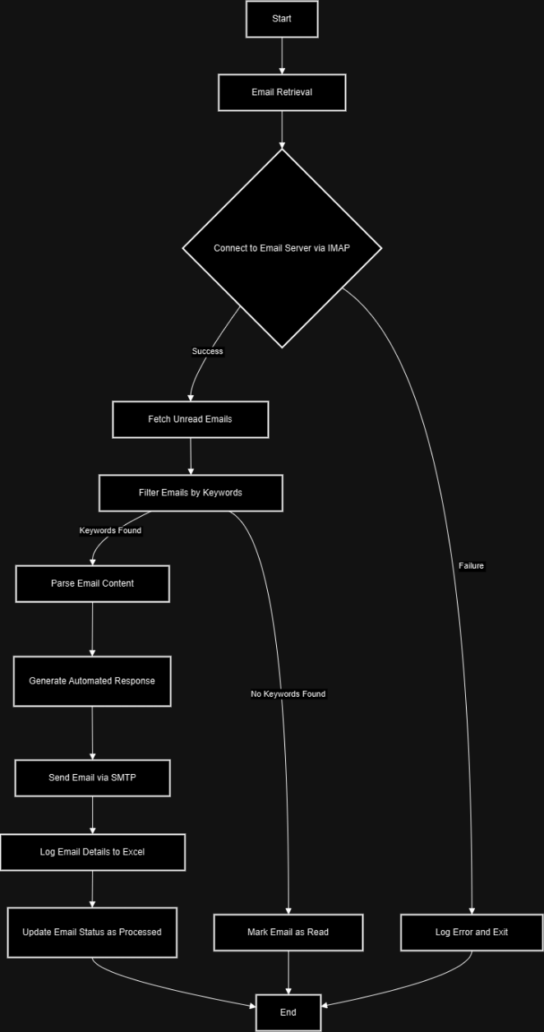
Architecture
Overall structure of my project

Slide 8
System Requirements
Hardware Requirements
  Processor: Dual-core processor (Intel i3 or equivalent) or higher.
  RAM: Minimum 8 GB for smooth operation.
  Storage: At least 50 GB free space for software, logs, and data storage.
  Display: Standard monitor with 1080p resolution.
  Internet Connection: Stable broadband connection for email access.
  Peripheral Devices: Keyboard, mouse, and optionally a printer for report generation.
Software Requirements
  Operating System: Windows 10 or higher, or macOS 10.13+.
  UiPath Studio: Installed and configured (preferably UiPath Cloud Studio).
  Email Client: Access to a configured IMAP/SMTP server (e.g., Gmail or any business email).
  Activity Packages:
    UiPath.Mail.Activities (for IMAP/SMTP functionality).
    UiPath.Excel.Activities (for logging emails to Excel).
  Microsoft Excel/LibreOffice: For managing email logs and reports.
  Programming Frameworks: .NET Framework 4.7.2 or higher for UiPath operations.

Slide 9
Functional Description
Module Name 1: Email Retrieval and Processing
  Short Description:
    The module uses IMAP to connect with the email server to retrieve unread emails. It will filter the emails according to specific keywords or patterns in the subject or body for processing into further action.
  Main Functions:
    Connect with the email server using IMAP.
    Retrieve unread e-mails.
    Parses the contents of the e-mail and identifies relevant keywords
    Mark processed e-mail as read
    DFD / Activity Diagram:
  DFD:
    User sets his email server credentials in the system.
    System connects to email server.
    Fetches emails and temporarily stores them in a queue.
    System processes the emails for keyword matching.
    The matched emails are forwarded to the response module.

Slide 10
Functional Description
Name of the Module 2: Automated Response and Logging
  Short Description:
    It auto-generates and sends predefined responses to emails as it matches the defined keywords. It also logs the details of emails such as sender, timestamp, subject, and response status into the Excel sheet for record-keeping.
  Key Functions:
    Generate predefined responses based on the matched keywords.
    SMTP is used for sending the responses.
    The processed email details are logged in an Excel sheet.
  DFD:
    System receives filtered email data from the processing module.
    Selects a predefined response template based on the keyword identified.
    Smtpsends the response back to the sender.
    Appends email details (sender, subject, response timestamp) to an Excel log file
    Updates the status of an email system (e.g., processed or responded to).

Slide 11
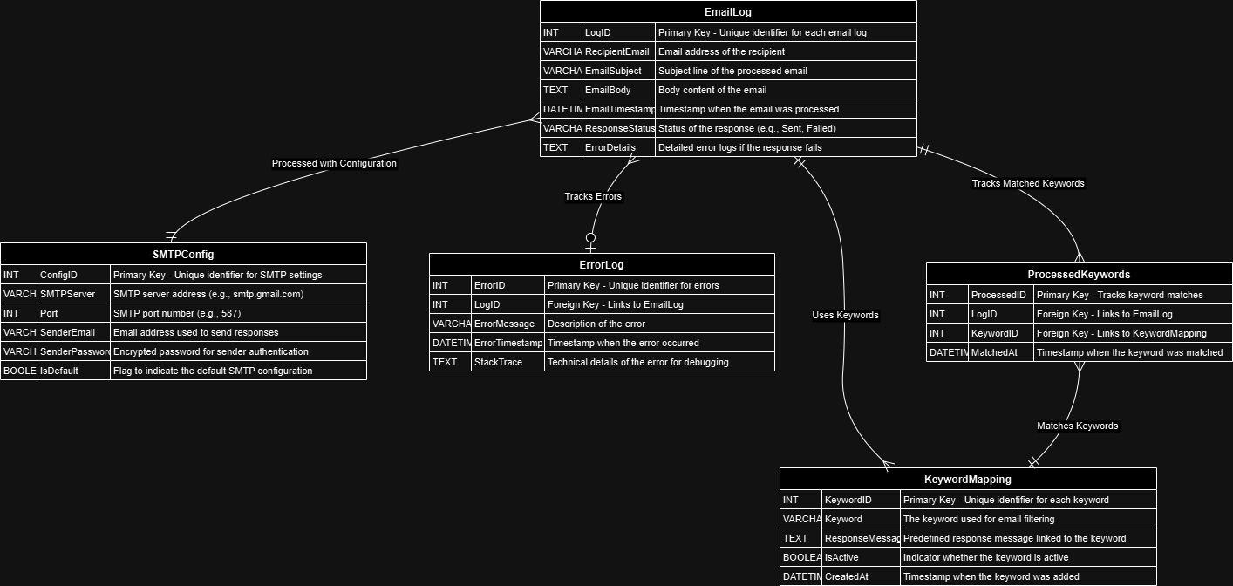
Table Design
ERD

Slide 12
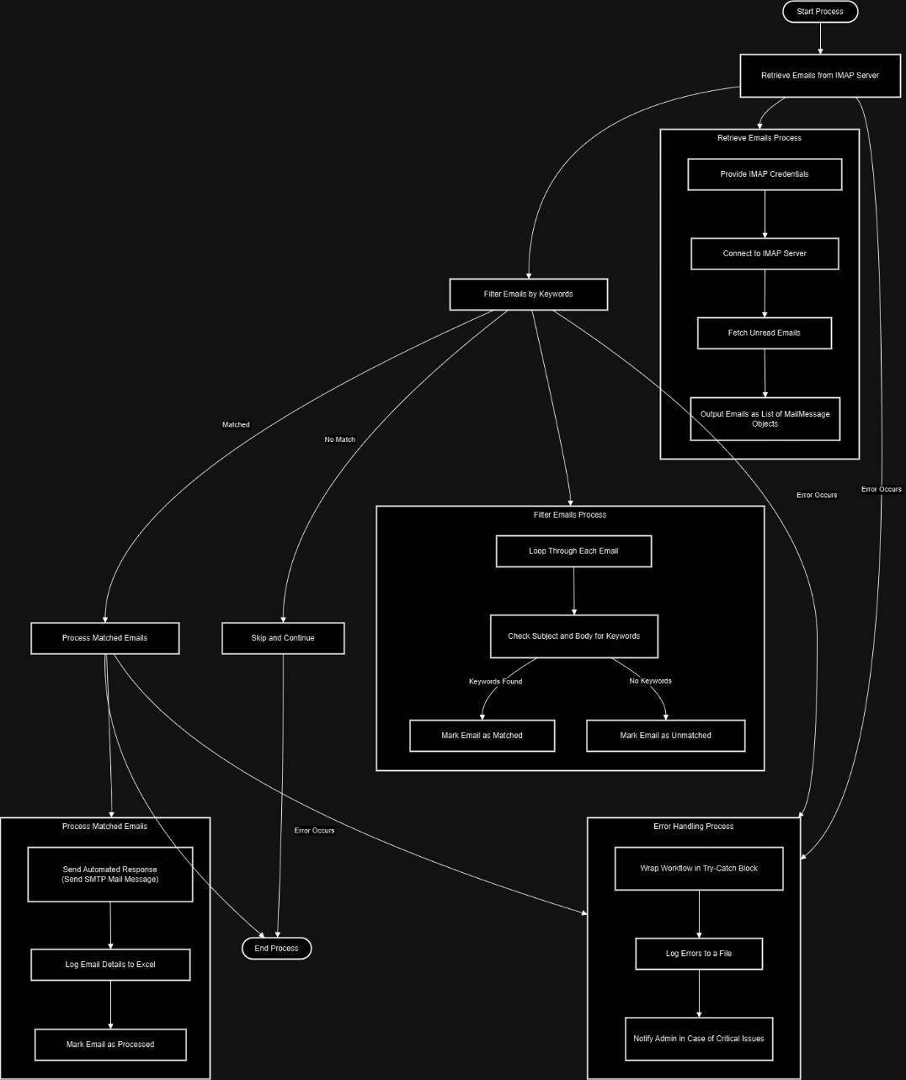
Process Design

Slide 13
Implementation
Implementation of Module 1: Email Fetching and Filtering
Description:
  This module connects to the IMAP server to fetch unread emails and filters out specific keywords in the subject or body. All are meant that only related emails will be forwarded for process while other related emails are ignored.
Steps
  IMAP settings
  Enter your IMAP credentials email, password, server address and port)
  Enable access of your email account to its IMAP service.
  Use the Get IMAP Mail Messages activity to retrieve unread emails.
  Then loop through the emails with a For Each loop.
  Use the keyword filter that checks in the subject and body of the email for keywords.

Slide 14
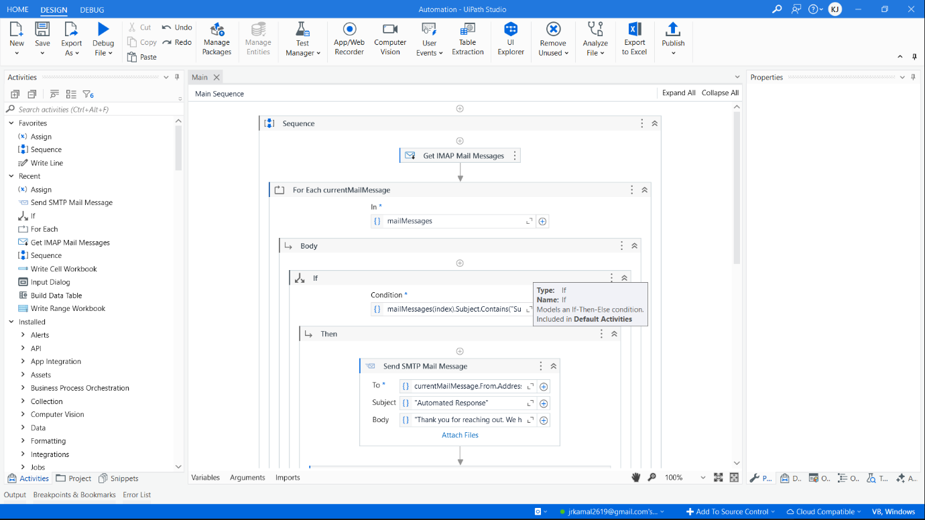
Implementation

Slide 15
Implementation
Implementation Module 2 Automated Response and Logging
Description:
  This module sends an automated response to filtered emails using SMTP but logs the details (recipient email, subject, timestamp) into an Excel file for tracking and auditing purposes.
Steps:
  Configure SMTP settings
  Input SMTP credentials which include email, password, server, and port.
  Use the Send SMTP Mail Message activity to send emails.
  Write a predefined automatic response, for example, "Thanks for reaching out. We will get back to you shortly.".
  Log the email details, namely the recipient, subject and timestamp, using Excel Application Scope and Write Cell activities.

Slide 16
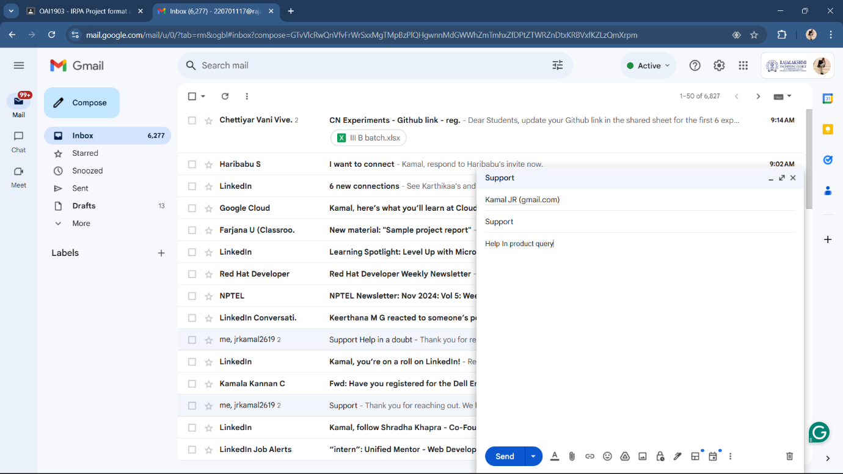
Testing
Sender Mail

Slide 17
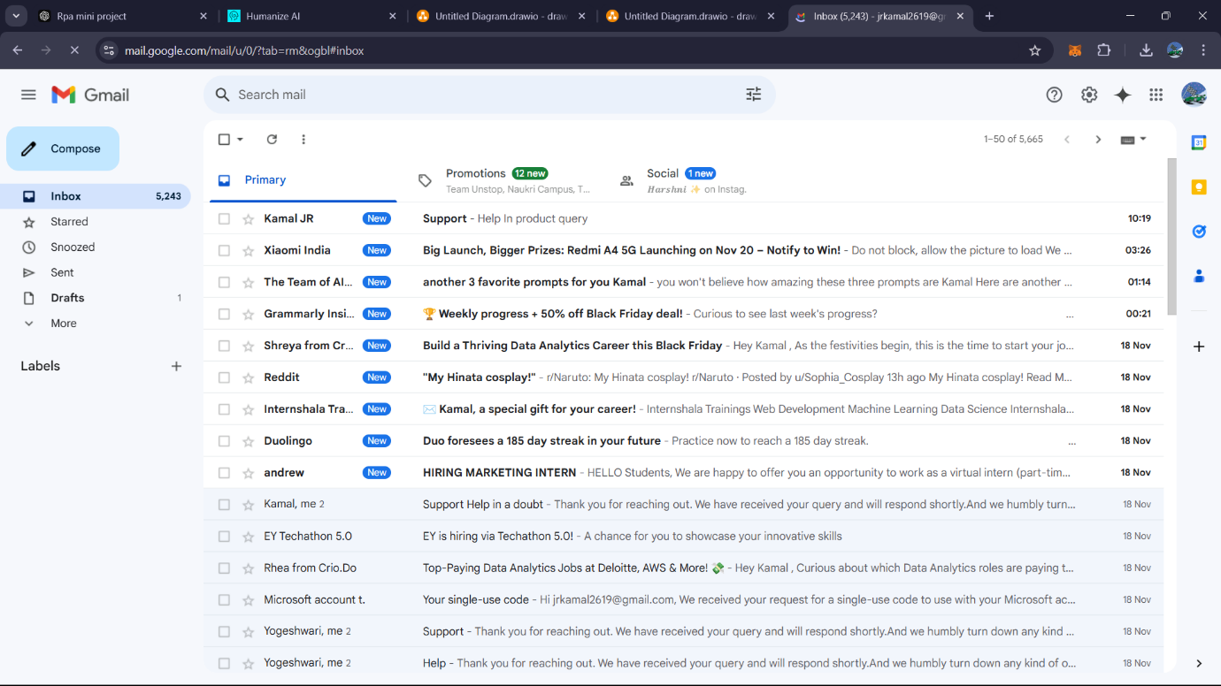
Testing
Receiver Mail (Unread)

Slide 18
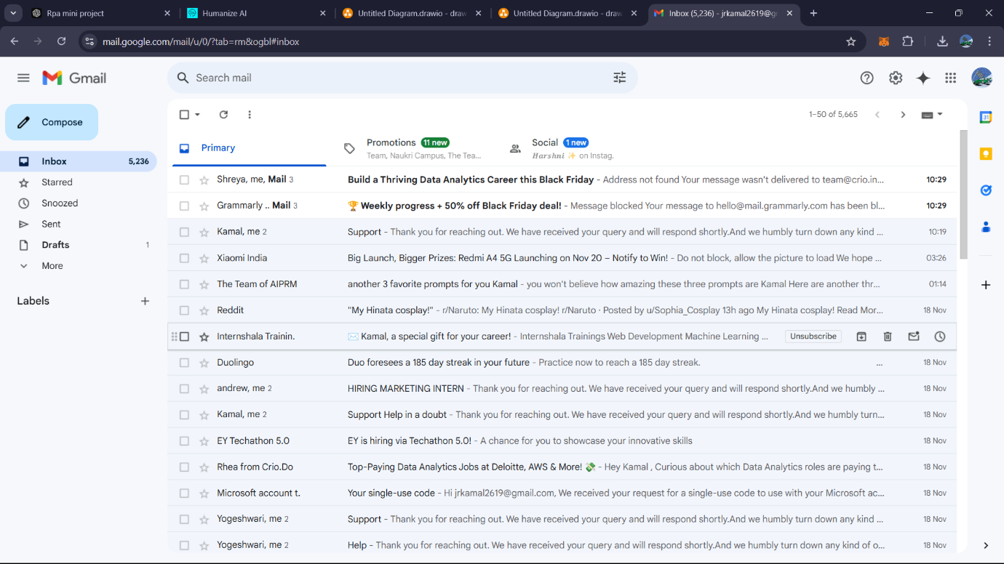
Testing
Mail Read

Slide 19
Testing
Mail Read

Slide 20
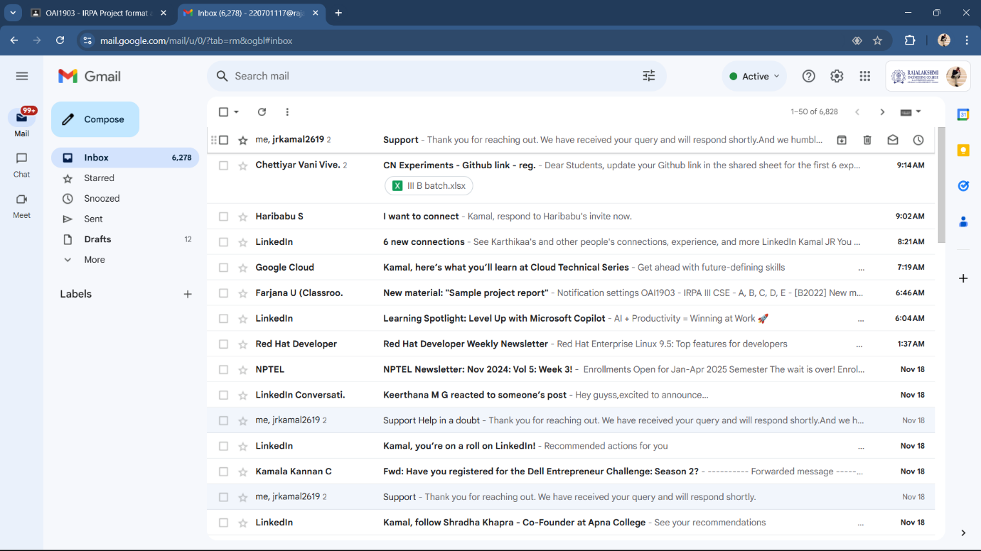
Testing
Mail Acknowledged

Slide 21
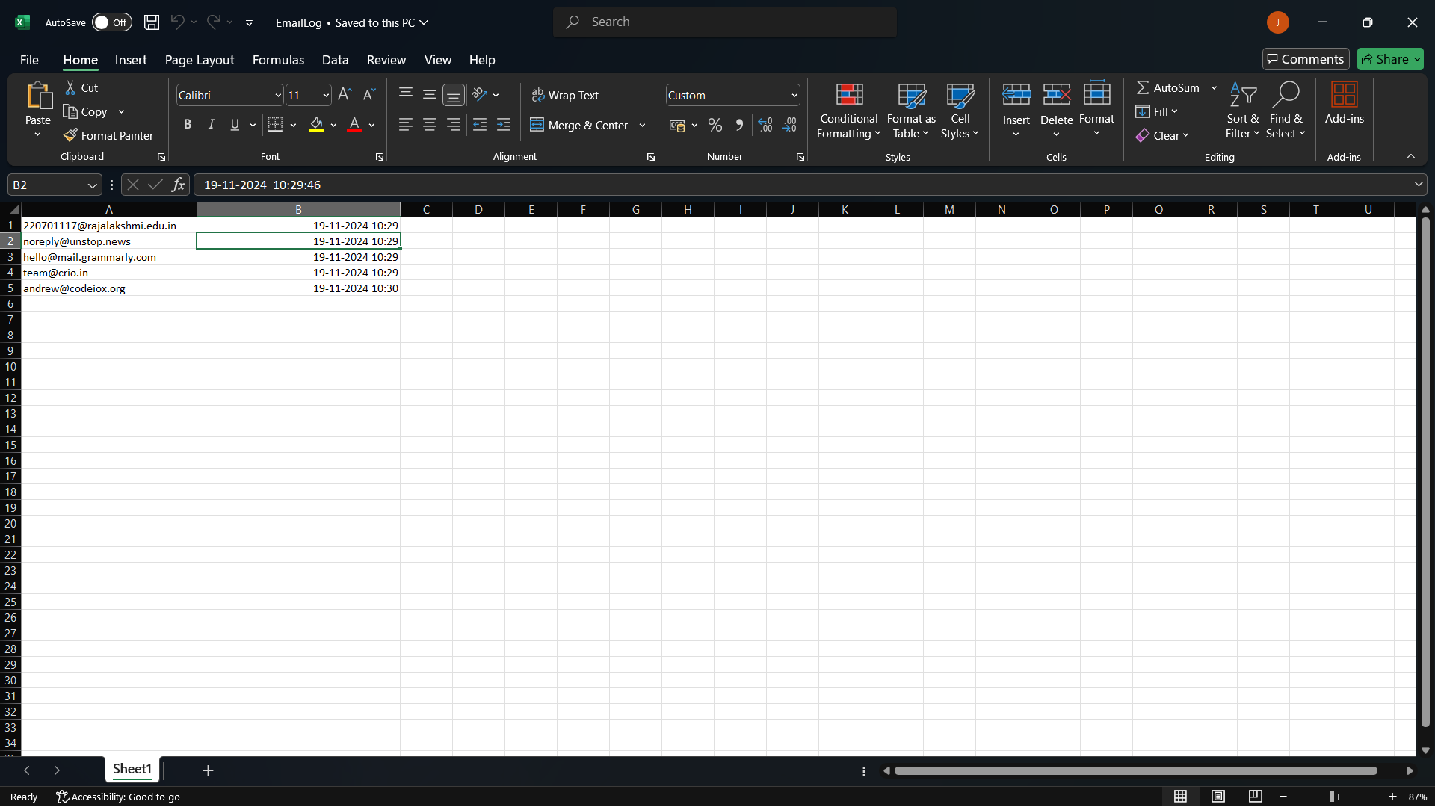
Testing
Mail Sent Excel Logging

Slide 22
Conclusions
The Automated Email Handling System, has shown significant improvements in the process of streamlining and automating an email communication management process. The integrated modular design has done well in overcoming major challenges attributed to the conventional or traditional modes of email handling that are handled manually. During the project, reducing response times, increasing the accuracy of replies with automation while being scalable enough to maintain maximum adaptability into future upgrades was of paramount importance.

Slide 23
Future Enhancement
Improved Keyword Matching:
  Work on advanced NLP methods that make detailed email content analysis.
  Apply appropriate machine learning models to classify and categorize the email so as to improve the detection of the keyword accurately.
Personalized Email Responses:
  Respond dynamically according to the context of the email, like the sender's name, type of question, or the urgency.
  Sustain a depository of templates according to types of queries, such as technical support and sales inquiries.
Multi-Account Support:
  Handle multiple email accounts; this will enable an organization to operate numerous inboxes.
Attachment Handling
  Attachment handling including download, analysis, or response based on attachments.
Dashboard Integration
  User-friendly dashboard to report and monitor real-time email processing.
  Statistics display such as the number of emails processed, responses sent, and errors encountered.

Slide 24
IEEE Paper
"Detecting Email Spam with NLP: A Machine Learning Approach"
This paper explores natural language processing (NLP) and machine learning techniques for classifying and filtering spam emails. It delves into implementing NLP tools for analyzing email content and identifying patterns indicative of spam.
Read more on IEEE Xplore​IEEE Xplore
"Sentiment Analysis for Automated Email Response System"
This study focuses on leveraging sentiment analysis within an email automation framework. It highlights the methodologies for understanding the sentiment of emails to improve the tone and relevance of automated responses.
Read more on IEEE Xplore​IEEE Xplore

Slide 25
References
Katz, J. & Lindell, Y. (2021). Introduction to Modern Cryptography. This book provides an in-depth understanding of security protocols, which could be useful for understanding secure email communication using IMAP and SMTP.
Manning, C. D., Raghavan, P., & Schütze, H. (2008). Introduction to Information Retrieval. A great resource for understanding text analysis and NLP techniques, essential for the content analysis module in your project.
Jurafsky, D., & Martin, J. H. (2020). Speech and Language Processing. This textbook is a comprehensive guide to NLP techniques, which are central to your email content analysis module.
Postel, J. B. (1982). RFC 821 - Simple Mail Transfer Protocol (SMTP). This RFC document outlines the standard for SMTP, useful for understanding the underlying principles of sending emails.
Crispin, M. (2003). RFC 3501 - Internet Message Access Protocol (IMAP) Version 4rev1. A technical specification detailing how IMAP works, providing foundational knowledge for the email retrieval aspect of your project.

Slide 26
Queries

Slide 27
Demonstration

Slide 28
Thank You

